Slide 1
Statistics Concepts I Wish I Had Understood When I Began My Career
Daniel J. Strom, Ph.D., CHP
Pacific Northwest National Laboratory
Richland, Washington USA
+1 509 375 2626 strom@pnl.gov
Presented to the Savannah River Chapter of the Health Physics Society
Aiken, South Carolina, 2011 April 15
PNNL-SA-67267
Notes:
I'll present on "Statistics concepts I wish I had understood when I began my career.“
I'll cover some of the material from "Hardest Concepts" and "Uncertainty Variability Bias Error Blunder".
In the afternoon, I'd like to present the disaggregation of variance problem. Title: "Making sense of uncertain, low-level measurements". I'll need 45 minutes for that. There are 2 files to give you a flavor.

Slide 2
Outline
Needs of occupational and environmental protection
Definitions of basic concepts
Bayesian and classical statistics
Shared and unshared uncertainties
Berkson (grouping) and classical (measurement) uncertainties
Autocorrelation
Decision threshold and minimum detectable amount
Censoring
Measurement
Modeling
Inference
Variability
Uncertainty
Bias
Error
Blunder
Notes:
Abstract of a 1-hour invited Continuing Education Lecture (CEL) to be presented at the 54th Annual Meeting of the Health Physics Society, Minneapolis, 13 July 2009
Uncertainty, Variability, Bias, Error, and Blunder
Daniel J. Strom; Pacific Northwest National Laboratory*
There have been many advances and refinements in the definitions of uncertainty, variability, and error, as well as substantial progress in computational and inferential approaches to handling problems dealing with these concepts. The longer you have been out of school, the more surprised you are likely to be with the current state of affairs. The profession of health physics can be viewed as risk-informed actions to keep radiation exposures and releases of radioactive materials to the environment as low as reasonably achievable. Health physics incorporates methods or results of many scientific disciplines, in particular in measurements of radiation and radioactive materials. Health physics uses estimates of health effects of radiation derived from epidemiology, radiation biology, and dose assessment. In each of these areas, the concepts of uncertainty, variability, and error are crucial for understanding and correct inference. How do uncertainty, variability, error, and blunder differ? The 1995 (2008) ISO Guide to the Expression of Uncertainty in Measurement decisively addressed metrology issues, but was silent on modeling issues and decisions based on metrology and modeling. The 2008 National Research Council Report addresses modeling and decision-making. Bayesian statistical inference has replaced classical inference in more and more areas of interest to health physicists, such as determining whether activity is present in a sample, what a detection system can be relied on to detect, and what can be inferred about intake and committed dose from bioassay data. The distinction between Berkson and classical errors, and how to deal with the resulting uncertainty has moved to the forefront of dose reconstruction for radiation epidemiology. The critical difference between shared and unshared uncertainties has led, over the past two decades, to a state-of-the-art practice using two-stage Monte Carlo calculations as pioneered by the Hanford Environmental Dose Reconstruction project. Autocorrelation over time of doses to individuals leads to a requirement to explicitly incorporate covariance into calculations, such as those in NIOSH's Interactive RadioEpidemiological Program (IREP). Variability of quantities of interest to health physicists over time and space, over ages and between sexes, and with lifestyle factors continues to require our attention. This presentation introduces and discusses these concepts, and speculates about their future in health physics.
*Pacific Northwest National Laboratory is operated for the U.S. Department of Energy by Battelle under Contract DE-AC05-76RL01830.
PNNL-SA-64767

Slide 3
Occupational and Environmental Protection
Requires rigorous understanding of the concepts of uncertainty, variability, bias, error, and blunder, which are crucial for understanding and correct inference
Deals with uncertain, low-level measurements, some of which may be zero or negative
Requires that decisions be made based on measurements
Consequences of wrong decisions may result in
  Needlessly frightened workers and public
  Disrupted work
  Wasted money
  Failure to protect health and the environment

Slide 4
2008 ISO Guide to the Expression of Uncertainty in Measurement (GUM)
Extensive, well-thought-out framework for dealing with uncertainty in measurement
  Clearly-defined concepts and terms
  Practical approach
Doesn’t cover
  the use of measurements in models that have uncertain
    assumptions
    parameters
    form
  representativeness (e.g., of a breathing-zone air sample)
  inference from measurements (e.g., dose-response relationship)
ISO. 2008. Uncertainty of Measurement - Part 3: Guide to the expression of uncertainty in measurement (GUM: 1995). Guide 98-3 (2008), International Organization for Standardization, Geneva, Switzerland.

Slide 5
2008 ISO GUM General Metrological Terms - 1
ISO-GUM Term | Meaning
(measurable) quantity | attribute of a phenomenon, body, or substance that may be distinguished qualitatively and determined quantitatively
value (of a quantity) | magnitude of a particular quantity generally expressed as a unit of measurement multiplied by a number
value of a measurand | particular quantity subject to measurement. [the unknown value of a physical quantity representing the “true state of Nature” This is sometimes called the “true value” or the “actual value”]
conventional true value (of a quantity) | value attributed to a particular quantity and accepted, sometimes by convention, as having an uncertainty appropriate for a given purpose
measurement | set of operations having the object of determining a value of a quantity

Slide 6
2008 ISO GUM General Metrological Terms - 3
ISO-GUM Term | Meaning
result of a measurement | value attributed to a measurand, obtained by measurement
uncorrected result | result of a measurement before correction for systematic error (i.e., bias)
corrected result | result of a measurement after correction for systematic error (i.e., bias)
accuracy of measurement | closeness of the agreement between the result of a measurement and a true value of the measurand
repeatability (of results of measurements) | closeness of the agreement between the results of successive measurements of the same measurand carried out under the same conditions of measurement
reproducibility (of results of measurements) | closeness of agreement between the results of measurements of the same measurand carried out under changed conditions of measurement

Slide 7
2008 ISO GUM General Metrological Terms - 5
ISO-GUM Term | Meaning
uncertainty (of measurement) | parameter, associated with the result of a measurement, that characterizes the dispersion of the values that could reasonably be attributed to the measurand. It is a bound for the likely size of the measurement error.
error (of measurement) | result of a measurement minus a true value of the measurand (i.e., the [unknowable] difference between a measured result the actual value of the measurand.) “Error is an idealized concept and errors cannot be known exactly” (Note 3.2.1)
relative error | error of measurement divided by a true value of the measurand
correction | value added algebraically to the uncorrected result of a measurement to compensate for systematic error
correction factor | Numerical factor by which the uncorrected result of a measurement is multiplied to compensate for systematic error

Slide 8
Types of Uncertainty in Models (Wikipedia)
Uncertainty due to variability of input and / or model parameters when the characterization of the variability is available (e.g., with probability density functions, pdf)
Uncertainty due to variability of input and/or model parameters when the corresponding variability characterization is not available
Uncertainty due to an unknown process or mechanism
Type 1 uncertainty, which depends on chance, may be referred to as aleatory or statistical uncertainty
Type 2 and 3 are referred to as epistemic or systematic uncertainties
http://en.wikipedia.org/wiki/Uncertainty_quantification

Slide 9
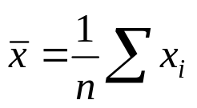
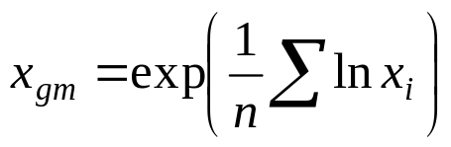

2008 ISO GUM Basic Statistical Terms & Concepts - 5
ISO-GUM Term | Meaning
arithmetic mean; average | the sum of values divided by the number of values:
Non- ISO-GUM Term | Meaning
geometric mean | the nth root of the product of n values: For 2 values,
median | the value in the middle of a distribution, such that there is an equal number of values above and below the median. Also known as the 50th percentile, x₅₀
mode | the most frequently occurring value

Slide 10
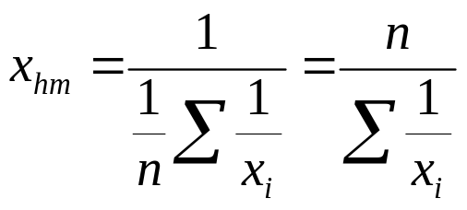
Non-ISO GUM
Basic Statistical Terms & Concepts
Non- ISO-GUM Term | Meaning
harmonic mean | the inverse of the average of the inverses:
Example in health physics: Suppose dose to biota is proportional to concentration in river water. For a given release rate (Bq/year), concentration in water is inversely proportional to flow rate in the river. Suppose you have river flow rate data for several years. You will correctly predict the average dose if you use the harmonic mean of the river flow rate data.
Another example in health physics: If you want the risk per sievert, you need the harmonic mean of the sieverts!

Slide 11
2008 ISO GUM Additional Terms & Concepts - 1
ISO-GUM Term | Meaning
blunder | “Blunders in recording or analyzing data can introduce a significant unknown error in the result of a measurement. Large blunders can usually be identified by a proper review of all the data; small ones could be masked by, or even appear as, random variations. Measures of uncertainty are not intended to account for such mistakes.” (3.4.7) Other terms include mistake and spurious error. [In software, blunders may be caused by “bugs.”]
“Type A” uncertainty evaluation | uncertainty that is evaluated by the statistical analysis of series of observations
“Type B” uncertainty evaluation | uncertainty that is evaluated by means other than the statistical analysis of a series of observations

Slide 12
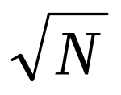
Type A and Type B Uncertainty
Uncertainty that is evaluated by the statistical analysis of series of observations is called a “Type A” uncertainty evaluation.
Uncertainty that is evaluated by means other than the statistical analysis of a series of observations is called a “Type B” uncertainty evaluation.
Note that using as an estimate of the standard deviation of N counts is a Type B uncertainty evaluation!

Slide 13
Uncertainty and Variability
Uncertainty
  stems from lack of knowledge, so it can be characterized and managed but not eliminated
  can be reduced by the use of more or better data
Variability
  is an inherent characteristic of a population, inasmuch as people vary substantially in their exposures and their susceptibility to potentially harmful effects of the exposures
  cannot be reduced, but it can be better characterized with improved information
-- National Research Council. 2008. Science and Decisions: Advancing Risk Assessment. http://www.nap.edu/catalog.php?record_id=12209, National Academies Press, Washington, DC

Slide 14
An Example of Variability in a Population

Slide 15
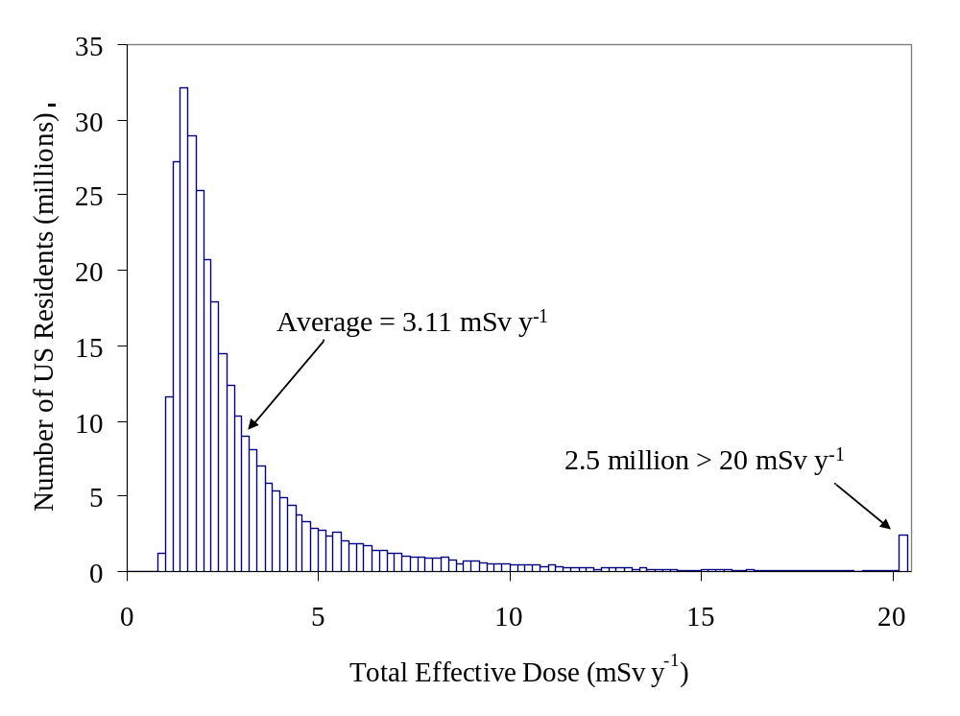
Distribution of Annual Effective Dose in the US Population Due to Ubiquitous Background Radiation
Notes:
15
Single object

Slide 16
Terms: Error, Uncertainty, Variability
“The difference between error and uncertainty should always be borne in mind.”
“For example, the result of a measurement after correction can unknowably be very close to the unknown value of the measurand, and thus have negligible error, even though it may have a large uncertainty.”
If you accept the ISO definitions of error and uncertainty
  there are no such things as “error bars” on a graph!
  such bars are “uncertainty bars”
Variability is the range of values for different individuals in a population
  e.g., height, weight, metabolism
Notes:
There is not always a simple correspondence between the classification of uncertainty components into categories A and B and the commonly used classification of uncertainty components as "random" and "systematic." The nature of an uncertainty component is conditioned by the use made of the corresponding quantity, that is, on how that quantity appears in the mathematical model that describes the measurement process. When the corresponding quantity is used in a different way, a "random" component may become a "systematic" component and vice versa. Thus the terms "random uncertainty" and "systematic uncertainty" can be misleading when generally applied. An alternative nomenclature that might be used is "component of uncertainty arising from a random effect," "component of uncertainty arising from a systematic effect," where a random effect is one that gives rise to a possible random error in the current measurement process and a systematic effect is one that gives rise to a possible systematic error in the current measurement process. In principle, an uncertainty component arising from a systematic effect may in some cases be evaluated by method A while in other cases by method B (see subsection 2.2), as may be an uncertainty component arising from a random effect.
NOTE – The difference between error and uncertainty should always be borne in mind. For example, the result of a measurement after correction (see subsection 5.2) can unknowably be very close to the unknown value of the measurand, and thus have negligible error, even though it may have a large uncertainty (see the Guide [2]).

Slide 17
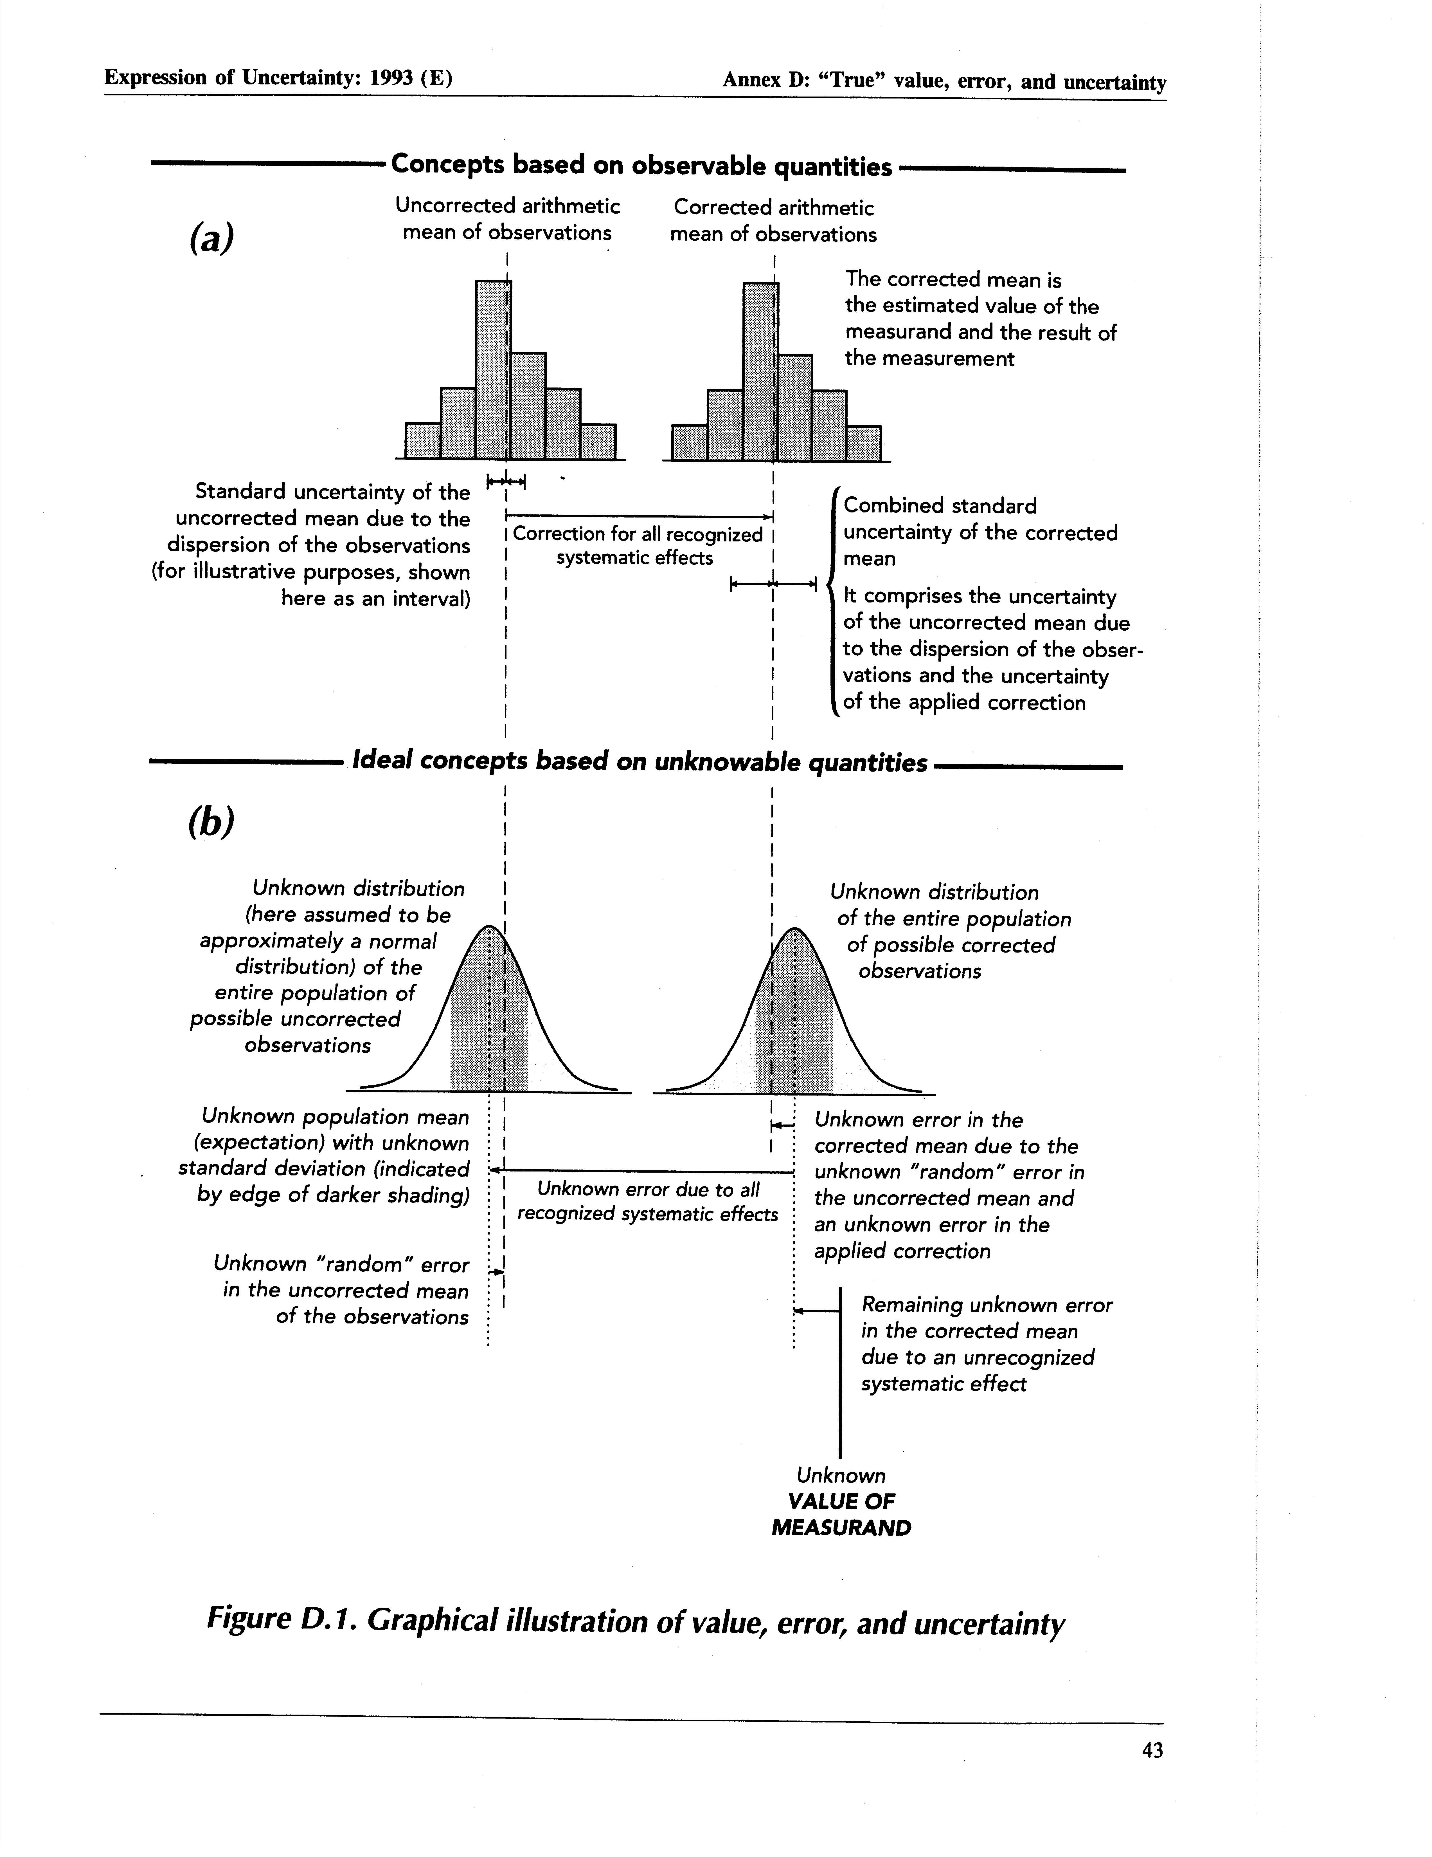
Graphical Illustration of Value, Error, and Uncertainty

Slide 18
Graphical Illustration of Value, Error, and Uncertainty

Slide 19
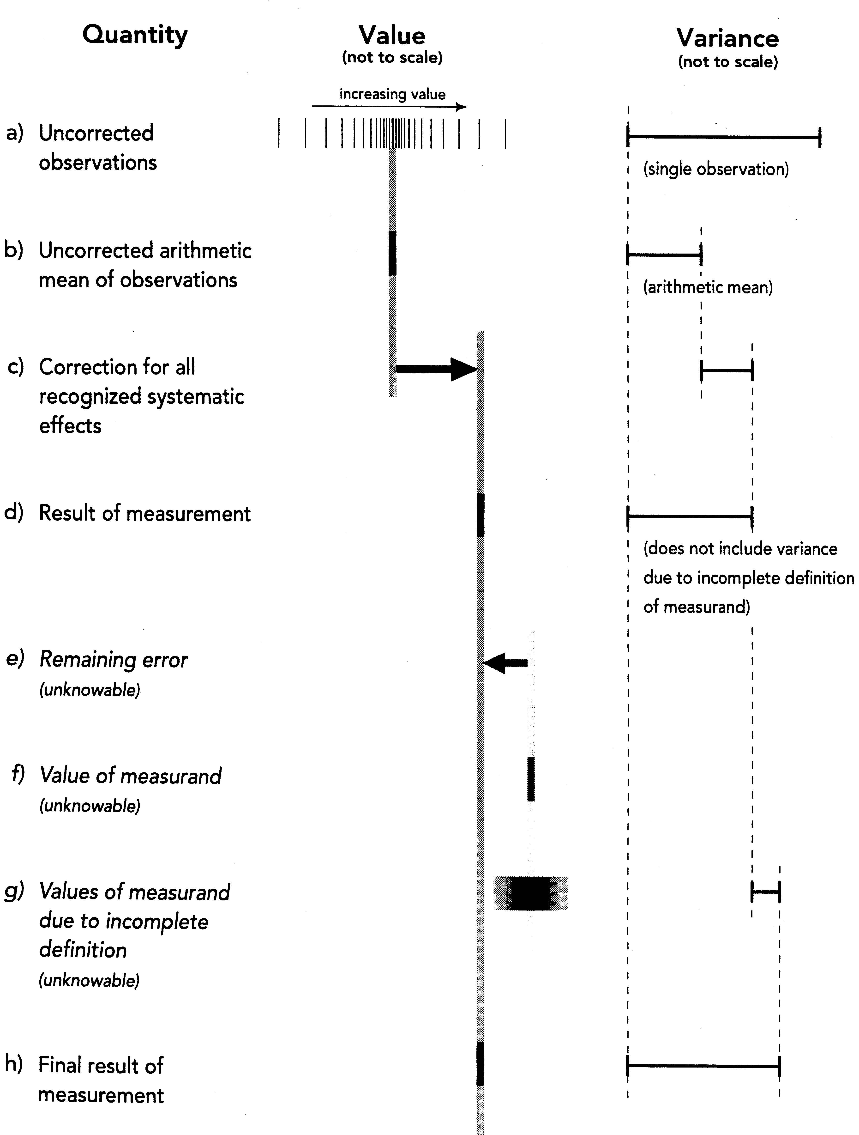
Graphical Illustration of Value, Error, and Uncertainty

Slide 20
Random and Systematic “Errors”
ISO-GUM Term | Meaning
random error | result of a measurement minus the mean that would result from an infinite number of measurements of the measurand carried out under repeatability conditions
systematic error | mean that would result from an infinite number of measurements of the same measurand carried out under repeatability conditions minus a true value of the measurand
Uncertainty is our estimate of how large the error may be
We do not know how large the error actually is
Notes:
There is not always a simple correspondence between the classification of uncertainty components into categories A and B and the commonly used classification of uncertainty components as "random" and "systematic." The nature of an uncertainty component is conditioned by the use made of the corresponding quantity, that is, on how that quantity appears in the mathematical model that describes the measurement process. When the corresponding quantity is used in a different way, a "random" component may become a "systematic" component and vice versa. Thus the terms "random uncertainty" and "systematic uncertainty" can be misleading when generally applied. An alternative nomenclature that might be used is "component of uncertainty arising from a random effect," "component of uncertainty arising from a systematic effect," where a random effect is one that gives rise to a possible random error in the current measurement process and a systematic effect is one that gives rise to a possible systematic error in the current measurement process. In principle, an uncertainty component arising from a systematic effect may in some cases be evaluated by method A while in other cases by method B (see subsection 2.2), as may be an uncertainty component arising from a random effect.
NOTE – The difference between error and uncertainty should always be borne in mind. For example, the result of a measurement after correction (see subsection 5.2) can unknowably be very close to the unknown value of the measurand, and thus have negligible error, even though it may have a large uncertainty (see the Guide [2]).

Slide 21
Random and Systematic Uncertainty versus
Type A and Type B Uncertainty Evaluation
GUM: There is not always a simple correspondence between the classification of uncertainty components into categories A and B and the commonly used classification of uncertainty components as “random” and “systematic.”
The nature of an uncertainty component is conditioned by the use made of the corresponding quantity, that is, on how that quantity appears in the mathematical model that describes the measurement process.
When the corresponding quantity is used in a different way, a “random” component may become a “systematic” component and vice versa.
Notes:
There is not always a simple correspondence between the classification of uncertainty components into categories A and B and the commonly used classification of uncertainty components as "random" and "systematic." The nature of an uncertainty component is conditioned by the use made of the corresponding quantity, that is, on how that quantity appears in the mathematical model that describes the measurement process. When the corresponding quantity is used in a different way, a "random" component may become a "systematic" component and vice versa. Thus the terms "random uncertainty" and "systematic uncertainty" can be misleading when generally applied. An alternative nomenclature that might be used is "component of uncertainty arising from a random effect," "component of uncertainty arising from a systematic effect," where a random effect is one that gives rise to a possible random error in the current measurement process and a systematic effect is one that gives rise to a possible systematic error in the current measurement process. In principle, an uncertainty component arising from a systematic effect may in some cases be evaluated by method A while in other cases by method B (see subsection 2.2), as may be an uncertainty component arising from a random effect.
NOTE – The difference between error and uncertainty should always be borne in mind. For example, the result of a measurement after correction (see subsection 5.2) can unknowably be very close to the unknown value of the measurand, and thus have negligible error, even though it may have a large uncertainty (see the Guide [2]).

Slide 22
Random and Systematic Uncertainty
Thus the terms “random uncertainty” and “systematic uncertainty” can be misleading when generally applied.
An alternative nomenclature that might be used is “component of uncertainty arising from a random effect,” “component of uncertainty arising from a systematic effect,” where a random effect is one that gives rise to a possible random error in the current measurement process and a systematic effect is one that gives rise to a possible systematic error in the current measurement process. In principle, an uncertainty component arising from a systematic effect may in some cases be evaluated by method A while in other cases by method B, as may be an uncertainty component arising from a random effect.
Notes:
There is not always a simple correspondence between the classification of uncertainty components into categories A and B and the commonly used classification of uncertainty components as "random" and "systematic." The nature of an uncertainty component is conditioned by the use made of the corresponding quantity, that is, on how that quantity appears in the mathematical model that describes the measurement process. When the corresponding quantity is used in a different way, a "random" component may become a "systematic" component and vice versa. Thus the terms "random uncertainty" and "systematic uncertainty" can be misleading when generally applied. An alternative nomenclature that might be used is "component of uncertainty arising from a random effect," "component of uncertainty arising from a systematic effect," where a random effect is one that gives rise to a possible random error in the current measurement process and a systematic effect is one that gives rise to a possible systematic error in the current measurement process. In principle, an uncertainty component arising from a systematic effect may in some cases be evaluated by method A while in other cases by method B (see subsection 2.2), as may be an uncertainty component arising from a random effect.
NOTE – The difference between error and uncertainty should always be borne in mind. For example, the result of a measurement after correction (see subsection 5.2) can unknowably be very close to the unknown value of the measurand, and thus have negligible error, even though it may have a large uncertainty (see the Guide [2]).

Slide 23
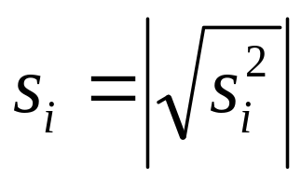
Type A Uncertainty Evaluation
represented by a statistically estimated standard deviation
associated number of degrees of freedom = v_{i}.
the standard uncertainty is u_{i} = s_{i}.
Notes:
Uncertainty that is evaluated by the statistical analysis of series of observations is called a “Type A” uncertainty evaluation.
Uncertainty that is evaluated by means other than the statistical analysis of a series of observations is called a “Type B” uncertainty evaluation.
An uncertainty component obtained by a Type A evaluation is represented by a statistically estimated standard deviation si, equal to the positive square root of the statistically estimated variance si2, and the associated number of degrees of freedom vi. For such a component the standard uncertainty is ui = si.

Slide 24
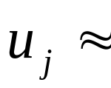
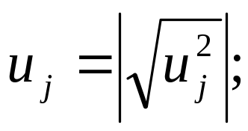
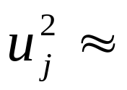
Type B Uncertainty Evaluation
represented by a quantity u_{j}
corresponding standard deviation
corresponding variance obtained from an assumed probability distribution based on all the available information
Since the quantity u_{j}² is treated like a variance and u_{j} like a standard deviation, for such a component the standard uncertainty is simply u_{j}.
Notes:
In a similar manner, an uncertainty component obtained by a Type B evaluation is represented by a quantity uj, which may be considered an approximation to the corresponding standard deviation; it is equal to the positive square root of uj2, which may be considered an approximation to the corresponding variance and which is obtained from an assumed probability distribution based on all the available information. Since the quantity uj2 is treated like a variance and uj like a standard deviation, for such a component the standard uncertainty is simply uj.

Slide 25
2008 ISO GUM Additional Terms & Concepts - 2
ISO-GUM Term | Meaning
combined standard uncertainty | standard uncertainty of the result of a measurement when that result is obtained from the values of a number of other quantities, equal to the positive square root of a sum of terms, the terms being the variances of covariances of these other quantities weighted according to how the measurement result varies with changes in these quantities.

Slide 26
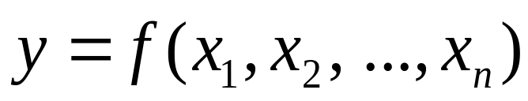
The First Step
Must know what y depends on, and how:

Slide 27
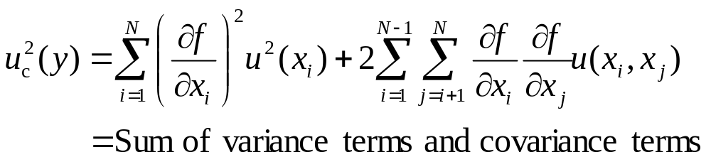
Uncertainty Propagation Formula
Combined standard uncertainty
Derived from first-order Taylor series expansion
Covariances usually unknown and ignored
Not accurate for large uncertainties (e.g., broad lognormal distributions)

Slide 28
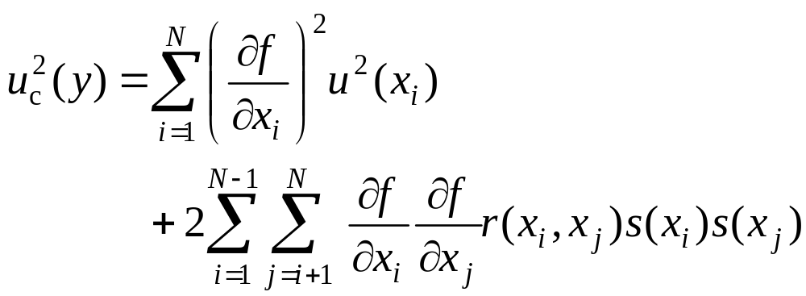
Uncertainty Propagation Formula – 2
Formulation using correlation coefficient r(x_{i},x_{j})
See Rolf Michel’s wipe test example:
  http://www.kernchemie.uni-mainz.de/downloads/saagas21/michel_2.pdf

Slide 29
Numerical Methods
Monte Carlo simulations, with covariances, may be needed to explore uncertainty
Crystal Ball™ does this easily

Slide 30
Measuring, Modeling, and Inference
Measuring is adequately addressed by many organizations
Modeling is required to infer quantities of interest from measurements
Examples of models
  dosimetric phantoms
  biokinetic models
  respiratory tract, GI tract, and wound models
  environmental transport and fate models
  dose-response models
Inference is the process of getting to what we want to know from what we have measured or observed

Slide 31
When Does Variability Become Uncertainty?
The population characteristic variability becomes uncertainty when a prediction is made for an individual, based on knowledge of that population
Example: How tall is a human being you haven’t met?
  If you have no other information, this has a range from 30 cm to 240 cm
  If you have age, weight, sex, race, nationality, etc., you can narrow it down

Slide 32
Classical and Bayesian Statistics
Bayesian statistical inference has replaced classical inference in more and more areas of interest to health physicists, such as determining whether activity is present in a sample, what a detection system can be relied on to detect, and what can be inferred about intake and committed dose from bioassay data.

Slide 33
Example: The Two Counting Problems
Radioactive decay is a Bernoulli process described by a binomial or Poisson distribution
  A Bernoulli process is one concerned with the count of the total number of independent events, each with the same probability, occurring in a specified number of trials
The “forward problem”
  from properties of the process, we predict the distribution of counting results (mean, standard deviation (SD))
  measurand → distribution of possible observations
The “reverse problem”
  measure a counting result
  from the counting result, we infer the parameters of the underlying binomial or Poisson distribution (mean, SD)
  see, e.g., Rainwater and Wu (1947)
  this is the problem we’re really interested in!

Slide 34
Two Kinds of Statistics
Classical statistics
  does the forward problem well
  does not do the reverse problem
Bayesian statistics does the reverse problem using
  a prior probability distribution
  the observed results
  a likelihood function (a classical expression of the forward problem)

Slide 35
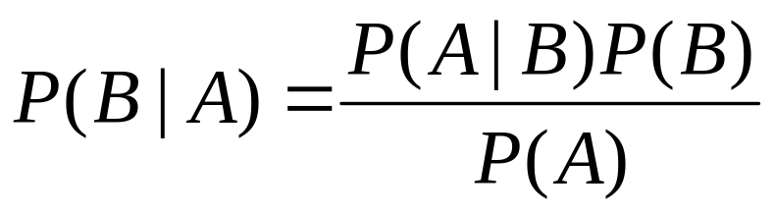
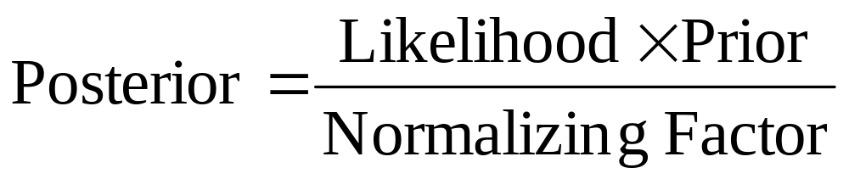
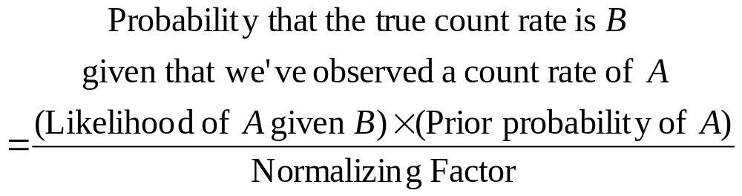
Bayes’s Rule (Simple form)
Names:
Example

Slide 36
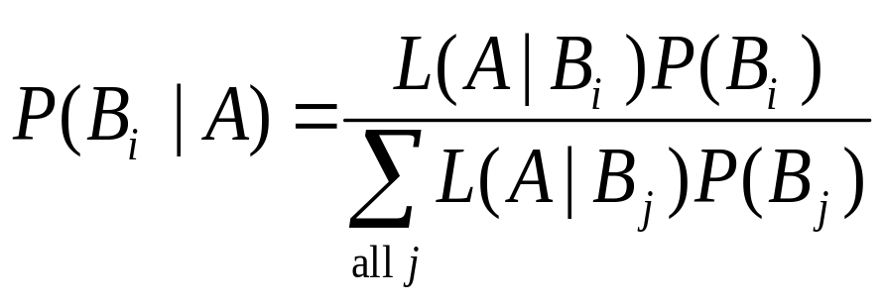
Bayesian Approach:
The Prior Probability 1
Some form of prior probability is required!
The prior probability is what you know before you start
The prior can have more or less effect on the posterior, depending on the precision of the data
The prior can be subjective
The prior is the topic of unresolvable arguments

Slide 37
Bayesian Approach: The Prior Probability 2
The prior can be “nothing”
  even “nothing” can take several forms
  “uniform,” “flat,” or “uninformative” prior: all values of B are “equally probable”
  “vague” prior: all values of ln(B) are equally probable…
The prior can be other information (intake examples)
  the CAM alarmed or there was facial or skin contamination or a positive nasal swab
  the worker had a previous intake
The prior can be hard to nail down
  “small values of blank are more likely than large ones”

Slide 38
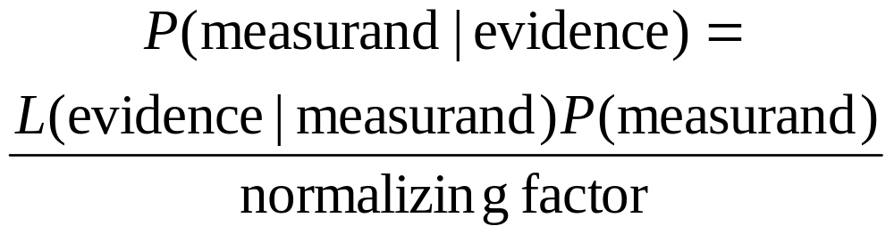
Philosophical Statement of Bayes’s Rule
The measurand or “state of nature” (e.g., count rate from analyte) is what we want to know
The “evidence” is what we have observed
The likelihood of the “evidence” given the measurand is what we know about the way nature works
The probability of the state of nature is what we believed before we obtained the evidence

Slide 39
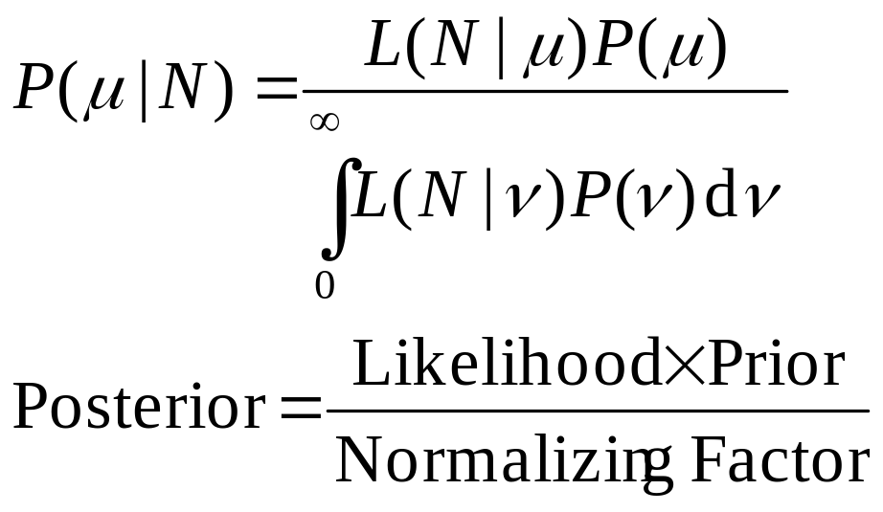
Bayes’s Rule: Continuous Form
P’s are probability densities
We want to determine the posterior probability density

Slide 40
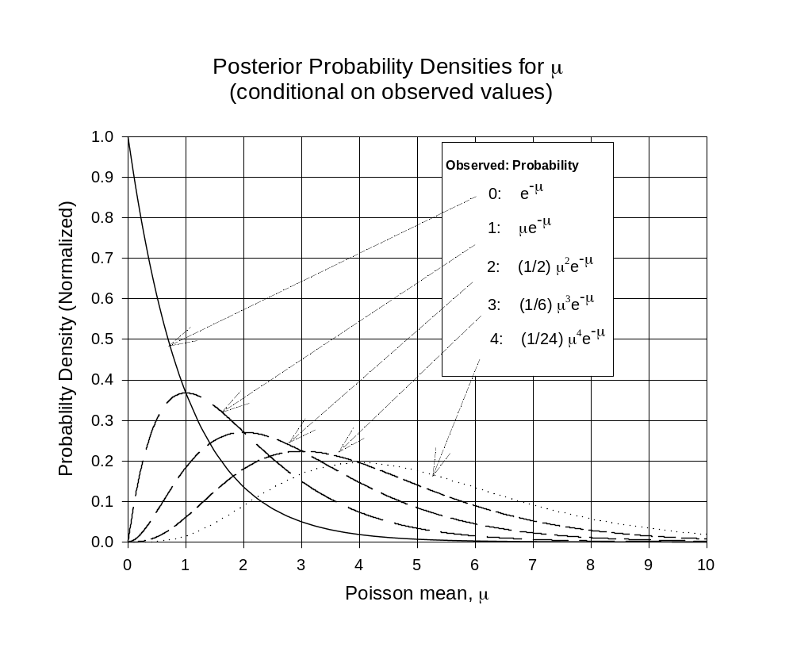

Slide 41

Implementation of Bayesian Statistical Methods in Health Physics
LANL has routinely used Markov Chain Monte Carlo methods for over a decade
  Pioneered by Guthrie Miller
  See work by Miller and others in RPD and HP
DOE uses the IMBA software package that incorporates the WeLMoS Bayesian method
  See work by Matthew Puncher and Alan Birchall in RPD
NCRP will likely endorse some Bayesian methods
The ISO 11929-series standards on decision thresholds and detection limits are all Bayesian
Semkow (2006) has explicitly solved the counting statistics problem for a variety of Bayesian priors
Semkow TM. 2006. "Bayesian Inference from the Binomial and Poisson Processes for Multiple Sampling." Chapter 24 in Applied Modeling and Computations in Nuclear Science, eds. TM Semkow, S Pommé, SM Jerome, and DJ Strom, pp. 335-356. American Chemical Society, Washington, DC.

Slide 42
ISO 11929:2010(E)
“Determination of the characteristic limits (decision threshold, detection limit and limits of the confidence interval) for measurements of ionizing radiation — Fundamentals and application”
Covers
  Simple counting
  Spectroscopic measurements
  The influence of sample treatment (e.g., radiochemistry)

Slide 43
MARLAP
“Multi-Agency Radiological Laboratory Analytical Protocols Manual. EPA 402-B-04-001A, B, and C”
http://www.epa.gov/radiation/marlap/manual.htm
Chapters 19 and 20 cover many statistical concepts related to radioactivity measurements

Slide 44
The Hardest Concepts I’ve Ever Tried to Communicate to a Health Physicist
What’s the smallest count rate that is almost certainly not background?
What’s the smallest real activity that I’m almost certain to detect if I use the decision threshold as my criterion?

Slide 45
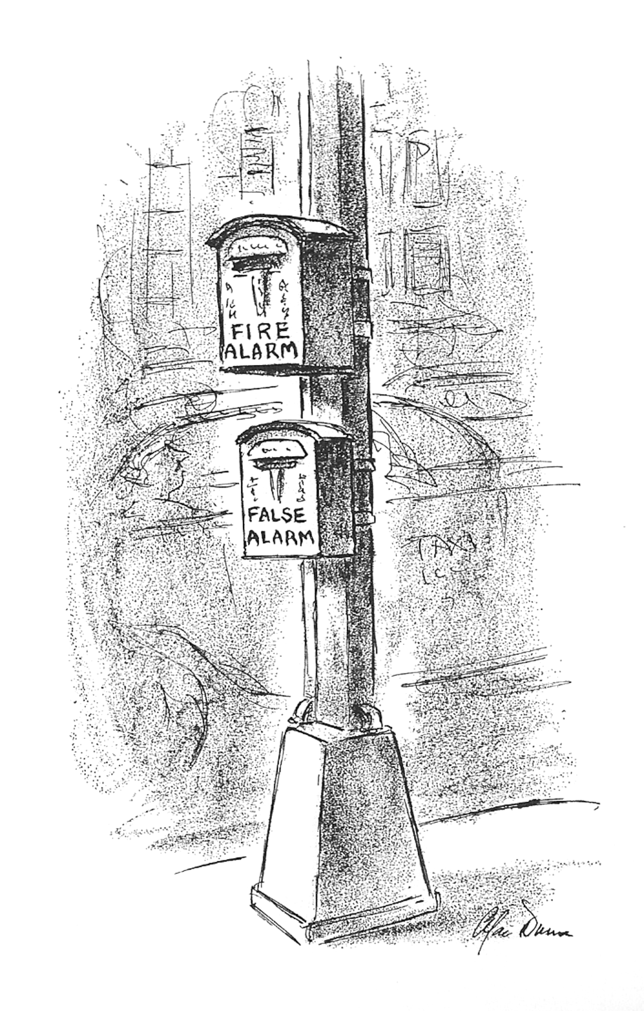
Alan Dunn in The New Yorker (1972)
Notes:
Alan Dunn’s first cartoon was published in the New Yorker in 1928. The last one in the big book is this one, 1972.

Slide 46
Outline
The problem: Hearing a whisper in a tempest
Nightmare terminology
Disaggregating two related concepts in counting statistics:
  “Critical Level” and “Detection Level” (Currie 1968)
  “Decision Level” and “Minimum Detectable Amount” (ANSI-HPS)
  “Decision Threshold” and “Detection Limit” (ISO, MARLAP)
What I wish I’d been taught
  A required concept: the measurand
  Population parameters and sample parameters
    Γρεεκ and Roman
    μεασυρανδ
7 Questions
Notes:
TPM-A.8 15:00 Tuesday, 2010 January 26
The Hardest Concepts I’ve Ever Tried to Communicate to a Health Physicist
Strom DJ
Pacific National Northwest Laboratory; strom@pnl. gov
From the earliest days of radiation protection growing out of the Manhattan Project, health physicists came to realize that it was important to detect tiny activities of alpha-emitters in the presence of background radiation, or small changes in the optical density of radiation sensitive film. However, too often they did not have the vocabulary to describe their problems. The vocabulary and concepts of measurement decisions and capabilities began to be developed in the 1960s. The vocabulary that has been used has been nondescriptive, confusing, or even seriously misleading. Furthermore, most health physicists are fairly sure they know what they mean by the words they use, and too often they are wrong. One key concept that was missing in my understanding is the notion of the measurand, which ISO defines as the true value of the quantity one wishes to measure. Two other key concepts are those of population parameters contrasted with sample parameters. The answers to the following questions involve the hardest concepts to communicate to health physicists and their managers: 1) For a given measurement system, how big does the signal need to be for one to decide that it is not just noise? 2) How does one decide whether a measurement represents a positive measurand and not a false alarm? 3) What do negative counting results mean? 4) What’s the smallest measurement one should record as greater than zero? 5) What is the largest measurand that one can fail to detect 5% of the time? 6) What is the smallest measurand that one will almost always detect? 7) What value of the measurand can one detect with 10% uncertainty? The long and varied list of names given to the answers to many of these questions indicates the need for a fresh start in communications to and among health physicists, managers, and regulators.

Slide 47
The Problem: Hearing a Whisper in a Tempest
Picking the signal out of the noise: Is anything there?
From the earliest days of radiation protection growing out of the Manhattan Project, health physicists came to realize that it was important to detect
  tiny activities of alpha-emitters in the presence of background radiation
  small changes in the optical density of radiation sensitive film
Vocabulary to describe their problems didn’t exist
Vocabulary and concepts of measurement decisions and capabilities began to be developed in the 1960s
Vocabulary
  non-descriptive
  confusing
  even seriously misleading
Worse, most HPs are fairly sure they know what they mean by the words they use, and too often they are wrong
47
Notes:
From the earliest days of radiation protection growing out of the Manhattan Project, health physicists came to realize that it was important to detect tiny activities of alpha-emitters in the presence of background radiation, or small changes in the optical density of radiation sensitive film. However, too often they did not have the vocabulary to describe their problems. The vocabulary and concepts of measurement decisions and capabilities began to be developed in the 1960s. The vocabulary that has been used has been nondescriptive, confusing, or even seriously misleading. Furthermore, most health physicists are fairly sure they know what they mean by the words they use, and too often they are wrong. One key concept that was missing in my understanding is the notion of the measurand, which ISO defines as the true value of the quantity one wishes to measure. Two other key concepts are those of population parameters contrasted with sample parameters. The answers to the following questions involve the hardest concepts to communicate to health physicists and their managers: 1) For a given measurement system, how big does the signal need to be for one to decide that it is not just noise? 2) How does one decide whether a measurement represents a positive measurand and not a false alarm? 3) What do negative counting results mean? 4) What’s the smallest measurement one should record as greater than zero? 5) What is the largest measurand that one can fail to detect 5% of the time? 6) What is the smallest measurand that one will almost always detect? 7) What value of the measurand can one detect with 10% uncertainty? The long and varied list of names given to the answers to many of these questions indicates the need for a fresh start in communications to and among health physicists, managers, and regulators.

Slide 48
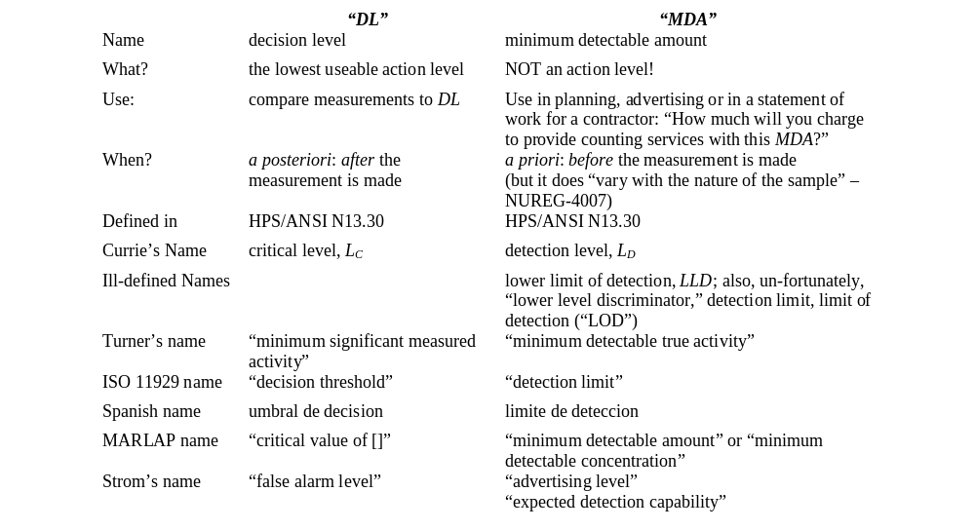
Terminology Is a Mess! and This Is Just in English!

Slide 49
What I Wish We’d All Been Taught
49
Notes:
One key concept that was missing in my understanding is the notion of the measurand, which ISO defines as the true value of the quantity one wishes to measure. Two other key concepts are those of population parameters contrasted with sample parameters. The answers to the following questions involve the hardest concepts to communicate to health physicists and their managers: 1) For a given measurement system, how big does the signal need to be for one to decide that it is not just noise? 2) How does one decide whether a measurement represents a positive measurand and not a false alarm? 3) What do negative counting results mean? 4) What’s the smallest measurement one should record as greater than zero? 5) What is the largest measurand that one can fail to detect 5% of the time? 6) What is the smallest measurand that one will almost always detect? 7) What value of the measurand can one detect with 10% uncertainty? The long and varied list of names given to the answers to many of these questions indicates the need for a fresh start in communications to and among health physicists, managers, and regulators.

Slide 50
The Measurand: The True Value of the Quantity One Wishes to Measure
The goal: measurement of a well-defined physical quantity that can be characterized by an essentially unique value
ISO calls the ‘true state of nature’ the measurand
  1980
  International Organization for Standardization (ISO). 2008. Uncertainty of Measurement - Part 3: Guide to the expression of uncertainty in measurement (GUM: 1995). Guide 98-3 (2008), Geneva.
50
Notes:
One key concept that was missing in my understanding is the notion of the measurand, which ISO defines as the true value of the quantity one wishes to measure. Two other key concepts are those of population parameters contrasted with sample parameters. The answers to the following questions involve the hardest concepts to communicate to health physicists and their managers: 1) For a given measurement system, how big does the signal need to be for one to decide that it is not just noise? 2) How does one decide whether a measurement represents a positive measurand and not a false alarm? 3) What do negative counting results mean? 4) What’s the smallest measurement one should record as greater than zero? 5) What is the largest measurand that one can fail to detect 5% of the time? 6) What is the smallest measurand that one will almost always detect? 7) What value of the measurand can one detect with 10% uncertainty? The long and varied list of names given to the answers to many of these questions indicates the need for a fresh start in communications to and among health physicists, managers, and regulators.

Slide 51
Population Parameters:
Characteristics of the Measurand
By convention, Greek letters denote population parameters
These reflect the measurand, the “true state of Nature” whose value we are trying to infer from measurements
Measurands:
  ρ : long-term count rates of sample and blank (per s)
  A: the activity of the sample (Bq)
    Actually, the difference in activity between sample and blank
Detection Level, Minimum Detectable Amount, Detection Limit: these identical quantities are population statistics
If only they’d written Λ_{Δ}, ΜΔΑ, ΔΛ
51
Notes:
One key concept that was missing in my understanding is the notion of the measurand, which ISO defines as the true value of the quantity one wishes to measure. Two other key concepts are those of population parameters contrasted with sample parameters. The answers to the following questions involve the hardest concepts to communicate to health physicists and their managers: 1) For a given measurement system, how big does the signal need to be for one to decide that it is not just noise? 2) How does one decide whether a measurement represents a positive measurand and not a false alarm? 3) What do negative counting results mean? 4) What’s the smallest measurement one should record as greater than zero? 5) What is the largest measurand that one can fail to detect 5% of the time? 6) What is the smallest measurand that one will almost always detect? 7) What value of the measurand can one detect with 10% uncertainty? The long and varied list of names given to the answers to many of these questions indicates the need for a fresh start in communications to and among health physicists, managers, and regulators.

Slide 52
Sample Parameters:
What We Can Observe
By convention, Roman letters denote observables, the sample parameters
Examples of sample parameters
  R: observed count rates of blank and sample (per s)
The Critical Level L_{C}, the Decision Level DL, and the Decision Threshold are all sample statistics
52
Notes:
One key concept that was missing in my understanding is the notion of the measurand, which ISO defines as the true value of the quantity one wishes to measure. Two other key concepts are those of population parameters contrasted with sample parameters. The answers to the following questions involve the hardest concepts to communicate to health physicists and their managers: 1) For a given measurement system, how big does the signal need to be for one to decide that it is not just noise? 2) How does one decide whether a measurement represents a positive measurand and not a false alarm? 3) What do negative counting results mean? 4) What’s the smallest measurement one should record as greater than zero? 5) What is the largest measurand that one can fail to detect 5% of the time? 6) What is the smallest measurand that one will almost always detect? 7) What value of the measurand can one detect with 10% uncertainty? The long and varied list of names given to the answers to many of these questions indicates the need for a fresh start in communications to and among health physicists, managers, and regulators.

Slide 53
The hardest concepts to communicate to health physicists and their managers
For a given measurement system, how big does the signal need to be for one to decide that it is not just noise?
How does one decide whether a measurement result represents a positive measurand and not a false alarm?
What do negative counting results mean?
What’s the smallest measurement result one should record as greater than zero?
What is the largest measurand that one can fail to detect 5% of the time?
What is the smallest measurand that one will almost always detect?
What value of the measurand can one detect with 10% uncertainty?
53
Notes:
One key concept that was missing in my understanding is the notion of the measurand, which ISO defines as the true value of the quantity one wishes to measure. Two other key concepts are those of population parameters contrasted with sample parameters. The answers to the following questions involve the hardest concepts to communicate to health physicists and their managers: 1) For a given measurement system, how big does the signal need to be for one to decide that it is not just noise? 2) How does one decide whether a measurement represents a positive measurand and not a false alarm? 3) What do negative counting results mean? 4) What’s the smallest measurement one should record as greater than zero? 5) What is the largest measurand that one can fail to detect 5% of the time? 6) What is the smallest measurand that one will almost always detect? 7) What value of the measurand can one detect with 10% uncertainty? The long and varied list of names given to the answers to many of these questions indicates the need for a fresh start in communications to and among health physicists, managers, and regulators.

Slide 54
Decision Threshold
Alan Dunn in The New Yorker (1972)
Notes:
Alan Dunn’s first cartoon was published in the New Yorker in 1928. The last one in the big book is this one, 1972.

Slide 55
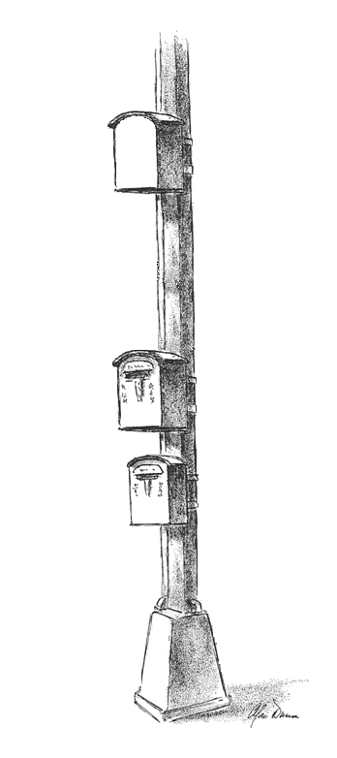
No Handle to Pull!
ΜΔΑ
(μδα)
Irrelevant After Measurement
Unlikely to be noise: Pull handle!
DL
Decision Threshold
Too likely to be noise: Don’t pull handle.
noise
Notes:
Alan Dunn’s first cartoon was published in the New Yorker in 1928. The last one in the big book is this one, 1972.

Slide 56


Conclusions
One frequently detects results that are less than the MDA but greater than the DT/DL
Never compare a result with an MDA; always compare it with the DT/DL
Use the ISO or MARLAP DT/DL and MDA if you want the right answer; use traditional DT/DL and MDA only if required by a regulator or on an exam
  Strom and MacLellan. 2001. "Evaluation of Eight Decision Rules for Low-Level Radioactivity Counting." Health Phys 81(1):27-34
56
Notes:
One key concept that was missing in my understanding is the notion of the measurand, which ISO defines as the true value of the quantity one wishes to measure. Two other key concepts are those of population parameters contrasted with sample parameters. The answers to the following questions involve the hardest concepts to communicate to health physicists and their managers: 1) For a given measurement system, how big does the signal need to be for one to decide that it is not just noise? 2) How does one decide whether a measurement represents a positive measurand and not a false alarm? 3) What do negative counting results mean? 4) What’s the smallest measurement one should record as greater than zero? 5) What is the largest measurand that one can fail to detect 5% of the time? 6) What is the smallest measurand that one will almost always detect? 7) What value of the measurand can one detect with 10% uncertainty? The long and varied list of names given to the answers to many of these questions indicates the need for a fresh start in communications to and among health physicists, managers, and regulators.

Slide 57
Always compare a result with DL
Never compare a result with MDA!
<DL
<MDA
57
Notes:
One key concept that was missing in my understanding is the notion of the measurand, which ISO defines as the true value of the quantity one wishes to measure. Two other key concepts are those of population parameters contrasted with sample parameters. The answers to the following questions involve the hardest concepts to communicate to health physicists and their managers: 1) For a given measurement system, how big does the signal need to be for one to decide that it is not just noise? 2) How does one decide whether a measurement represents a positive measurand and not a false alarm? 3) What do negative counting results mean? 4) What’s the smallest measurement one should record as greater than zero? 5) What is the largest measurand that one can fail to detect 5% of the time? 6) What is the smallest measurand that one will almost always detect? 7) What value of the measurand can one detect with 10% uncertainty? The long and varied list of names given to the answers to many of these questions indicates the need for a fresh start in communications to and among health physicists, managers, and regulators.

Slide 58
Always compare a result with DL
Never compare a result with ΜΔΑ!
<DL
<MΔA
58
Notes:
One key concept that was missing in my understanding is the notion of the measurand, which ISO defines as the true value of the quantity one wishes to measure. Two other key concepts are those of population parameters contrasted with sample parameters. The answers to the following questions involve the hardest concepts to communicate to health physicists and their managers: 1) For a given measurement system, how big does the signal need to be for one to decide that it is not just noise? 2) How does one decide whether a measurement represents a positive measurand and not a false alarm? 3) What do negative counting results mean? 4) What’s the smallest measurement one should record as greater than zero? 5) What is the largest measurand that one can fail to detect 5% of the time? 6) What is the smallest measurand that one will almost always detect? 7) What value of the measurand can one detect with 10% uncertainty? The long and varied list of names given to the answers to many of these questions indicates the need for a fresh start in communications to and among health physicists, managers, and regulators.

Slide 59
“Censoring” of Data
Censoring data means changing measured results from numbers to some other form that cannot be added or averaged or analyzed numerically
Examples of data censoring
  Left-censoring
    changing results that are less than some value to zero
    changing results that are less than some value to “less than” some value
  Right-censoring
    changing values from the measured result to “greater than” some value
  Rounding

Slide 60
Why should censoring of data be avoided?
Censoring means changing the numbers
In a sense, it is dishonest
If results are ever
  summed,
  averaged, or
  used for some other aggregate analysis such as fitting a distribution,
censoring makes this
  difficult,
  impossible, or
  simply biased.

Slide 61
Censoring Examples
Five results for discharge from a pipe taken over 1 year
  uncensored results: −2, −1, 0, 1, and 2
  sum = 0 (total discharge for the year is 0)
  average = 0 (average discharge for the year is 0)
Example 1: Set negative values to zero
  censored results: 0, 0, 0, 1, and 2
  sum = 3 (i.e., total discharge for the year is 3; this is not true)
  average = 0.6 (i.e., average discharge for the year is 0.6; false)
Example 2: Suppose L_{C} = 2. Set all values < 2 to “<”
  censored results: <, <, <, <, and 2
  sum = ? (total discharge for the year cannot be determined)
  average = ? (average discharge for the year cannot be determined)

Slide 62
But Negative Activity Is Meaningless…
No, it’s not meaningless
Just like money, subtracting a big number from a small number gives a negative value
  You have 100€, you charge 200€, you owe 100€
  100€ − 200€ = −100€ (your net value)
  this doesn’t mean you can find a bank note for −100€
  stocks go up and down; the end of the year value includes all changes, positive and negative
Negative activity only means that random statistical fluctuations resulted in a negative number
If negative, zero, or less-than values are suppressed, the sum is biased.

Slide 63
More Reasons Not to Censor
Upper confidence limits of negative, zero, or less-than values
  may be small positive numbers
  needed for some applications (e.g., probability of causation)
Censoring is prohibited by many standards and regulations
  ANSI N13.30-1996: “Results obtained by the service laboratory shall be reported to the customer and shall include the following items …quantification using appropriate blank values of radionuclides whether positive, negative, or zero”
  Many U.S. Department of Energy regulations require reporting raw data, calculated results (positive, negative, or zero), and total propagated uncertainties
  Decision on actions can be made with uncensored data

Slide 64
Rounding Is Censoring
Rounding a number is
  changing its value
  biasing the value
  censoring
Rounding often “justified” by claiming uncertainty
  Uncertainty does not justify changing the answer
  Explicitly state the uncertainty
Beware of converting units of a rounded number and then rounding again!
Intermediate results and laboratory records should never be rounded
The only time to round is in presentations or communications

Slide 65
Report and Record All Measurements with No Censoring and Minimal Rounding
Censoring

Slide 66

“Nondetects” Is a Must-Read
Classical (frequentist), not Bayesian
Dennis Helsel (USGS) has studied the problem for decades
Points out the shortcomings of common methods such as censoring by imputing
  0
  DL/2
  DL
Helsel DR. 2005. Nondetects and Data Analysis. Statistics for Censored Environmental Data. John Wiley & Sons, Hoboken, New Jersey.

Slide 67
What if...?
How would occupational and environmental protection change if exposure and dose limits applied to the upper 95% confidence limit of a measured or modeled value?
Employers would have 2 incentives:
  Reduce doses so that the “upper 95” was below the limit
  Reduce uncertainty in assessment of occupational exposures so that small doses with formerly large uncertainties would have an “upper 95” below the limit
Either effect would be good for the worker!
  The worker would be assured of being protected regardless of the employer’s ability to monitor dose
  Impact would be large for protection of some workers
Regulation of chemical exposures on the “upper 95” suggested by Leidel and Busch in 1977...

Slide 68
Summary 1
There have been many new developments in the science of uncertainty
Meanings of common words have crystallized
Error is the unknown and unknowable difference between the measurand and our value
Uncertainty is our estimate of how large the error may be
Variability is a natural characteristic of a population
Metrology terminology is mature, but modeling continues to evolve
An incorrect estimate of a parameter caused by incorrect treatment of uncertainty is called a biased estimate
A blunder is a mistake

Slide 69
Summary 2
Bayesian statistical inference provides a formal way of using all available knowledge to produce a probability distribution of unknown parameters
Uncertainty analysis for populations must account for
  Berkson (grouping) and classical (measurement) errors
  Shared and unshared errors
  Autocorrelations over time within individuals
Multiple realizations of possibly true doses that correctly treat the effects of various uncertainties on inferences of dose-response relationships are necessary for unbiased radiation risk estimates
Sophisticated treatment of uncertainty is becoming a requirement in more areas of health physics, including measuring, modeling, and inference

Slide 70
Always compare a result with DL
Never compare a result with ΜΔΑ!
<DL
<MΔA
70
Notes:
One key concept that was missing in my understanding is the notion of the measurand, which ISO defines as the true value of the quantity one wishes to measure. Two other key concepts are those of population parameters contrasted with sample parameters. The answers to the following questions involve the hardest concepts to communicate to health physicists and their managers: 1) For a given measurement system, how big does the signal need to be for one to decide that it is not just noise? 2) How does one decide whether a measurement represents a positive measurand and not a false alarm? 3) What do negative counting results mean? 4) What’s the smallest measurement one should record as greater than zero? 5) What is the largest measurand that one can fail to detect 5% of the time? 6) What is the smallest measurand that one will almost always detect? 7) What value of the measurand can one detect with 10% uncertainty? The long and varied list of names given to the answers to many of these questions indicates the need for a fresh start in communications to and among health physicists, managers, and regulators.

Slide 71
Report and Record All Measurements with No Censoring and Minimal Rounding
Censoring

Slide 72
Questions?
Please e-mail Strom@pnl.gov for unanswered questions, references or other information regarding this talk

Slide 73
Outline
Needs of occupational and environmental protection
Definitions of basic concepts
Bayesian and classical statistics
Shared and unshared uncertainties
Berkson (grouping) and classical (measurement) uncertainties
Autocorrelation
Recent developments
Measurement
Modeling
Inference
Variability
Uncertainty
Bias
Error
Blunder
Notes:
Abstract of a 1-hour invited Continuing Education Lecture (CEL) to be presented at the 54th Annual Meeting of the Health Physics Society, Minneapolis, 13 July 2009
Uncertainty, Variability, Bias, Error, and Blunder
Daniel J. Strom; Pacific Northwest National Laboratory*
There have been many advances and refinements in the definitions of uncertainty, variability, and error, as well as substantial progress in computational and inferential approaches to handling problems dealing with these concepts. The longer you have been out of school, the more surprised you are likely to be with the current state of affairs. The profession of health physics can be viewed as risk-informed actions to keep radiation exposures and releases of radioactive materials to the environment as low as reasonably achievable. Health physics incorporates methods or results of many scientific disciplines, in particular in measurements of radiation and radioactive materials. Health physics uses estimates of health effects of radiation derived from epidemiology, radiation biology, and dose assessment. In each of these areas, the concepts of uncertainty, variability, and error are crucial for understanding and correct inference. How do uncertainty, variability, error, and blunder differ? The 1995 (2008) ISO Guide to the Expression of Uncertainty in Measurement decisively addressed metrology issues, but was silent on modeling issues and decisions based on metrology and modeling. The 2008 National Research Council Report addresses modeling and decision-making. Bayesian statistical inference has replaced classical inference in more and more areas of interest to health physicists, such as determining whether activity is present in a sample, what a detection system can be relied on to detect, and what can be inferred about intake and committed dose from bioassay data. The distinction between Berkson and classical errors, and how to deal with the resulting uncertainty has moved to the forefront of dose reconstruction for radiation epidemiology. The critical difference between shared and unshared uncertainties has led, over the past two decades, to a state-of-the-art practice using two-stage Monte Carlo calculations as pioneered by the Hanford Environmental Dose Reconstruction project. Autocorrelation over time of doses to individuals leads to a requirement to explicitly incorporate covariance into calculations, such as those in NIOSH's Interactive RadioEpidemiological Program (IREP). Variability of quantities of interest to health physicists over time and space, over ages and between sexes, and with lifestyle factors continues to require our attention. This presentation introduces and discusses these concepts, and speculates about their future in health physics.
*Pacific Northwest National Laboratory is operated for the U.S. Department of Energy by Battelle under Contract DE-AC05-76RL01830.
PNNL-SA-64767

